Slide 1

In the name of Allah, the most beneficent, the most merciful.

Slide 2
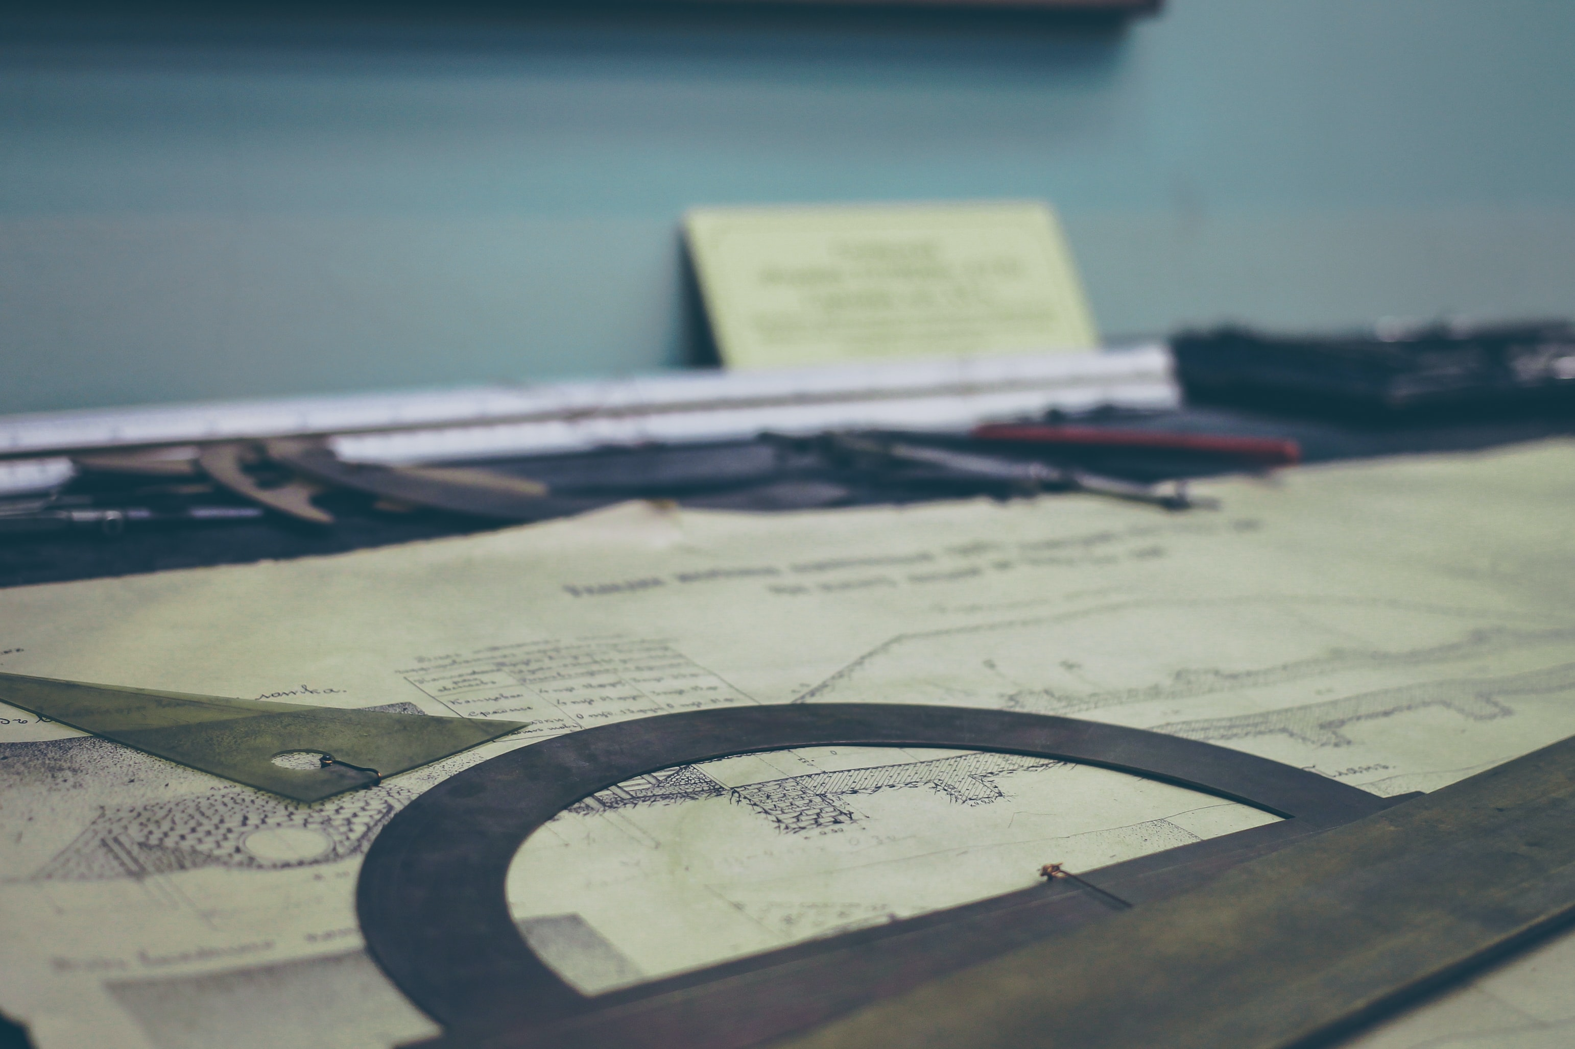
MMT-II Presentation
Team Members
Ammad Ejaz 19-ME-153
M. Waleed 19-ME-154
Saghar Ali Rabbani 19-ME-181
Haris Ejaz 19-ME-191
Abdul Rehman 19-ME-193

Slide 3
Principle of Virtual Work
The principle of virtual work states that in equilibrium the virtual work of the forces applied to a system is zero. Newton's laws state that at equilibrium the applied forces are equal and opposite to the reaction, or constraint forces. This means the virtual work of the constraint forces must be zero as well.

Slide 4
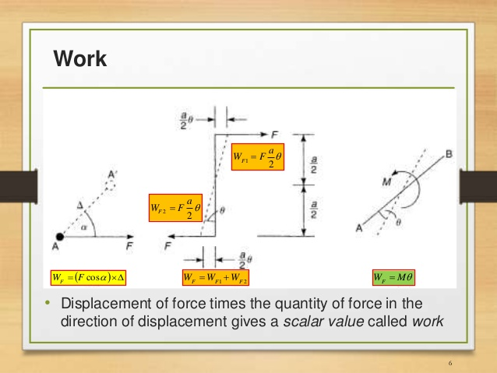

Slide 5
Principle of Virtual Work (PVW)
If a particle is in equilibrium under the action of a number of forces, the total work done by the forces for a small arbitrary displacement of the particle is zero.
If a particle is in equilibrium, the total virtual work of forces acting on the particle is zero for any virtual displacement. since work done by internal forces (equal, opposite, and collinear) cancels each other.

Slide 6

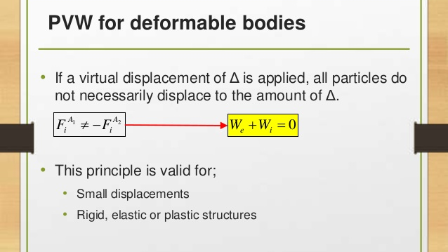



Slide 7
Note:
So far virtual work has been produced by actual forces in equilibrium moving through imposed virtual displacements.
Base on PVW, we can alternatively assume a set of virtual forces in equilibrium moving through actual displacements.
Application of this principle, gives a very powerful method to analyze indeterminate structures.

Slide 8
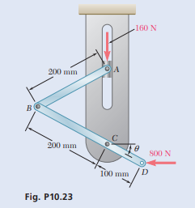
NUMERICAL Rod AB is attached to a block at A that can slide freely in the vertical slot shown. Neglecting the effect of friction and the weights of the rods, determine the value of θ corresponding to equilibrium.

Slide 9
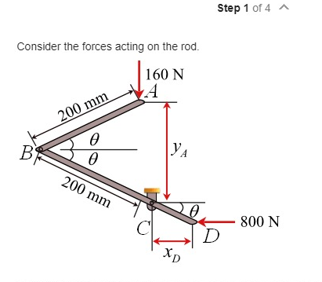

Slide 10
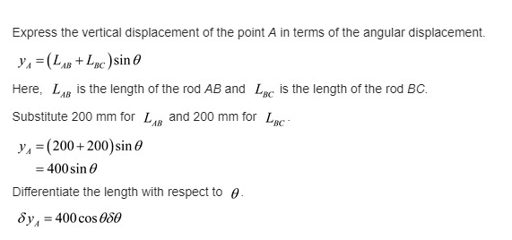
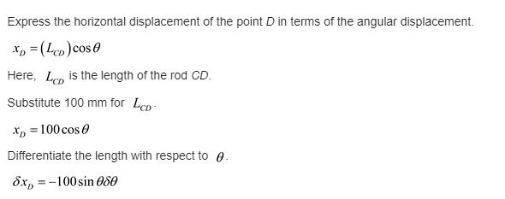
Calculations:

Slide 11
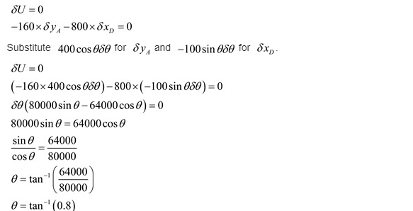

Slide 12
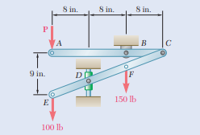
The two-bar linkage shown is supported by a pin and bracket at B and a collar at D that slides freely on a vertical rod. Determine the force P required to maintain the equilibrium of the linkage.
NUMERICAL

Slide 13
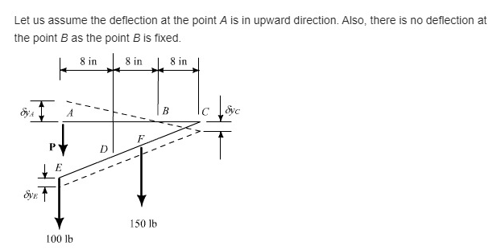

Slide 14
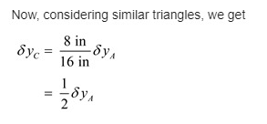
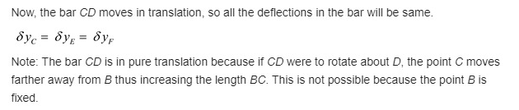

Slide 15
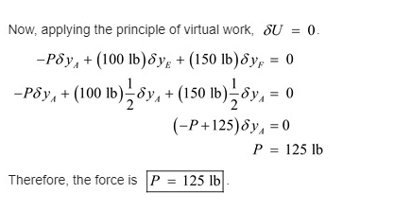

Slide 16

Thank You

